Slide 1

Financialization
Carlos Nuno Castel-Branco cnbranco@iseg.ulisboa.pt
Licenciatura Economia, Macroeconomics II
2022-2023

Slide 3
Definitions
Financial Capital – “capital” as means/activities/capabilities used to produce commodities for profits, with the employment of wage work. “Financial capital” means financial means/activities/capabilities used as capital.
Fictitious Capital – used as a counterpoint to “real capital”. Capital invested in credit securities (shares, bonds, debt bonds), which entitles holders to regularly appropriate a share of profits in the form of dividends or interest. Being the paper counterpart of real capital, fictitious capital has a special movement external to existing capital. Like a specific commodity, it is bought and sold on a special market—for example, the stock exchange—and acquires a price. But since these securities/shares/bonds have no [intrinsic] value, fluctuations in their market price do not necessarily coincide with changes in real capital, but can affect real capital.

Slide 4
Interest bearing capital and capital accumulation
Interest bearing capital can be useful to create productive capacities and innovate, although it bears a cost on production (the cost of financial capital, which is decided upfront).
  When interest bearing capital generates more interest bearing capital without the need for production, we are likely to be in the presence of the early stages of financialization, this is, the dominance of finance (and speculative finance) over the process of capital accumulation as a whole, including the mobilization and deployment of public resources
  Accumulation of real capital is replaced by accumulation of fictitious capital, and the dominance of interest bearing (IBC) capital can act against real investment

Slide 5
What is financialization?
Interest bearing capital can control assets (such as firms) but also what/how such firms do and how financial capital is deployed.
Examples over the last 4 decades: (i) financial transactions share of profits of non-financial organizations increased from 5% to > 45% (so that real investment and employment fell); (ii) weight of finance in global GDP more than quadrupled (why do we need 4+ times more financial services for the same real transactions?); (iii) increased role for offshores and fiscal heavens and shadow financing.

Slide 6
Where does financialization come from?
A product of neoliberalism and one of its main characteristics:
  Deregulation, including of the financial markets, to increase global mobility of capital at higher profit rates (offshores, shadow financing and fiscal heavens are examples of this)
  Concentration and centralization of income and capital – how to transform money into capital at “good enough” rates of return?
  Increased commoditization of the society, including of sectors/services where private capital was excluded from before (such as privatization/deregulation of social security, access to health, education, transports, defence and security, control of strategic resources such as land and strategic energy-minerals), through outsourcing, public/private “partnerships”, monopoly concessions and other means.

Slide 7
Where does financialization come from?
A product of neoliberalism and one of its main characteristics:
  Crises paid for by severe social austerity (cuts in social expenditure, employment, real wages and variations regarding monetary policy – from tight controls to quantitative easing and back). Social austerity cuts “social obligations of capital” (such as taxes and commitments to social protection and decent labour conditions), balances the deficit while enabling the government to focus on rescuing financial markets and institutions, and creates new profit opportunities by privatising and outsourcing social services (in health, education, social security, and so on).
  Expansion of the credit economy (credit cards, for example) to compensate for falling demand associated with stagnation in employment and real wages (please, watch this video online https://www.youtube.com/watch?v=qOP2V_np2c0)
  Increasing risks and debt, coupled with public guarantees, public subsidies and increased public exposure to private debt
  International competition for access to highly concentrated and centralized finance, which promotes product diversification as a way to maximise market dominance and profits.

Slide 8
What is financialization?
The term “financialization” is recent and has its roots in heterodox economic thought and Marxist political economy, being derived from the theoretical elaboration on the formation of financial capital from the fusion of industrial and banking capitalism and the dominance of the latter over the former, and builds on Marx's argument about interest-bearing capital and the role of fictitious capital accumulation and its parasitic character.
Financialization is the intensive and extensive accumulation of fictitious capital, i.e., the increasing scope and prevalence of finance capital used to create more finance capital, irrespective of the productive use of that capital, and without regard for the consequences of this fictitious process of accumulation in the real economy.

Slide 9
What is financialization?
Therefore, financialization is not the mere presence of financial operations, regardless of how intensive and extensive they may be, but it is the incorporation of these into new financial operations – for example, the sale and resale of packages of loan portfolios and miscellaneous debts – that provoke the extensive and intensive expansion of fictitious capital's dominance over finance and the economy. Under conditions of financialization, fictitious capital exercises control not only over surplus but also over corporate ownership and control.
The intensive and extensive expansion of the domain of fictitious capital can cause the contraction of real investment and accumulation, concentrating and centralizing capital in an unproductive way and reducing employment and well-being. This dynamic can be destabilizing and unsustainable, particularly if fictitious capital accumulation is substantially faster than real accumulation, as this tends to cause speculative bubbles that are followed by economic and financial collapses, makes real and fictitious accumulation substantially diverge, and prevents the potential returns on investments from materializing.

Slide 10
Circuit of industrial capital and tensions and conflits between capital and factions of capital
Conflicts about the distribution of surplus value between capitalists: profits, rents, interest, consumption
Conflicts about how to proceed with the accumulation of capital
Where does financial capital come from and its implications for the nature of the accumulation process?
M’
M
circulation
LP
Conflicts (class, gender, type of workers) over the conditions of
social reproduction and acess to labour
Realization of surplus value. Conflicts and horizontal competition with other capitalists. Forward linkages
C’
C
production
Conflicts over technology (class, gender, type of workers) and prices (with other capitalists – vertical competition). Backward linkages
MP
pp
Generation and extraction of surplus vale (absolute and relative). Conflicts (class, gender, group of workers) over the social and technical organization of production and employment conditions
Legend: M = money (M’ > M); C = commodities (C’ > C); LP = labour power, MP = means of production); pp = process of production; C’ = Commodities at the end of the prodcution process; M’ = Money at the end of the realization (of surplus value) process.

Slide 11
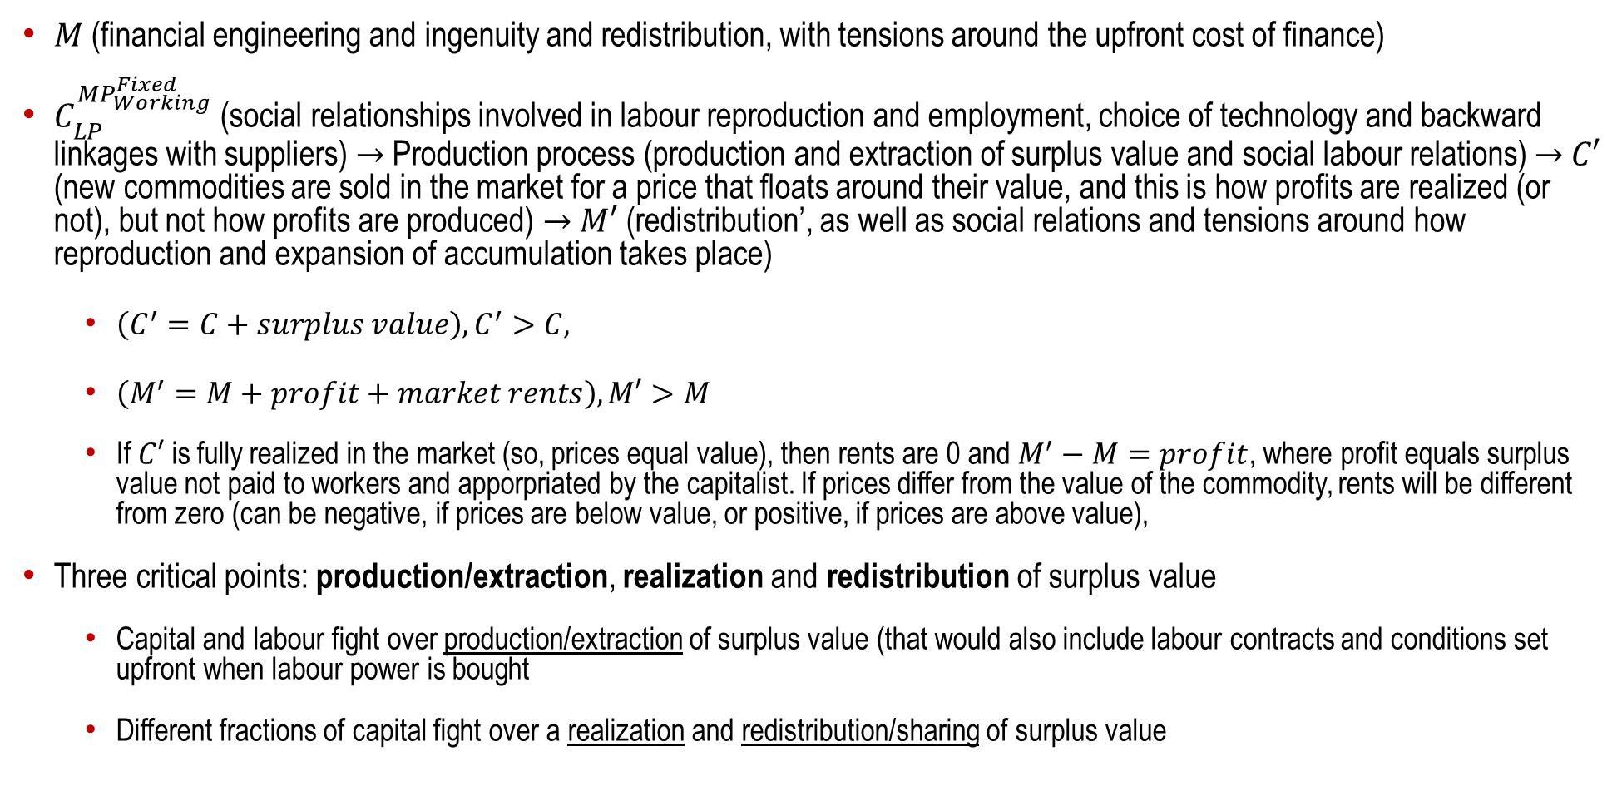
Circuit of industrial capital and tensions and conflits between capital and factions of capital
$M$ (financial engineering and ingenuity and redistribution, with tensions around the upfront cost of finance)
$C_{LP}^{{MP}_{Working}^{Fixed}}$ (social relationships involved in labour reproduction and employment, choice of technology and backward linkages with suppliers) → Production process (production and extraction of surplus value and social labour relations) → $C′$ (new commodities are sold in the market for a price that floats around their value, and this is how profits are realized (or not), but not how profits are produced) → $M′$ (redistribution’, as well as social relations and tensions around how reproduction and expansion of accumulation takes place)
  ${\left(C^{′}=C+surplus value\right), C}^{′}>C,$
  $\left(M^{′}=M+profit+market rents\right), M′>M$
  If $C′$ is fully realized in the market (so, prices equal value), then rents are 0 and $M^{′}−M=profit$, where profit equals surplus value not paid to workers and apporpriated by the capitalist. If prices differ from the value of the commodity, rents will be different from zero (can be negative, if prices are below value, or positive, if prices are above value),
Three critical points: production/extraction, realization and redistribution of surplus value
  Capital and labour fight over production/extraction of surplus value (that would also include labour contracts and conditions set upfront when labour power is bought
  Different fractions of capital fight over a realization and redistribution/sharing of surplus value

Slide 12
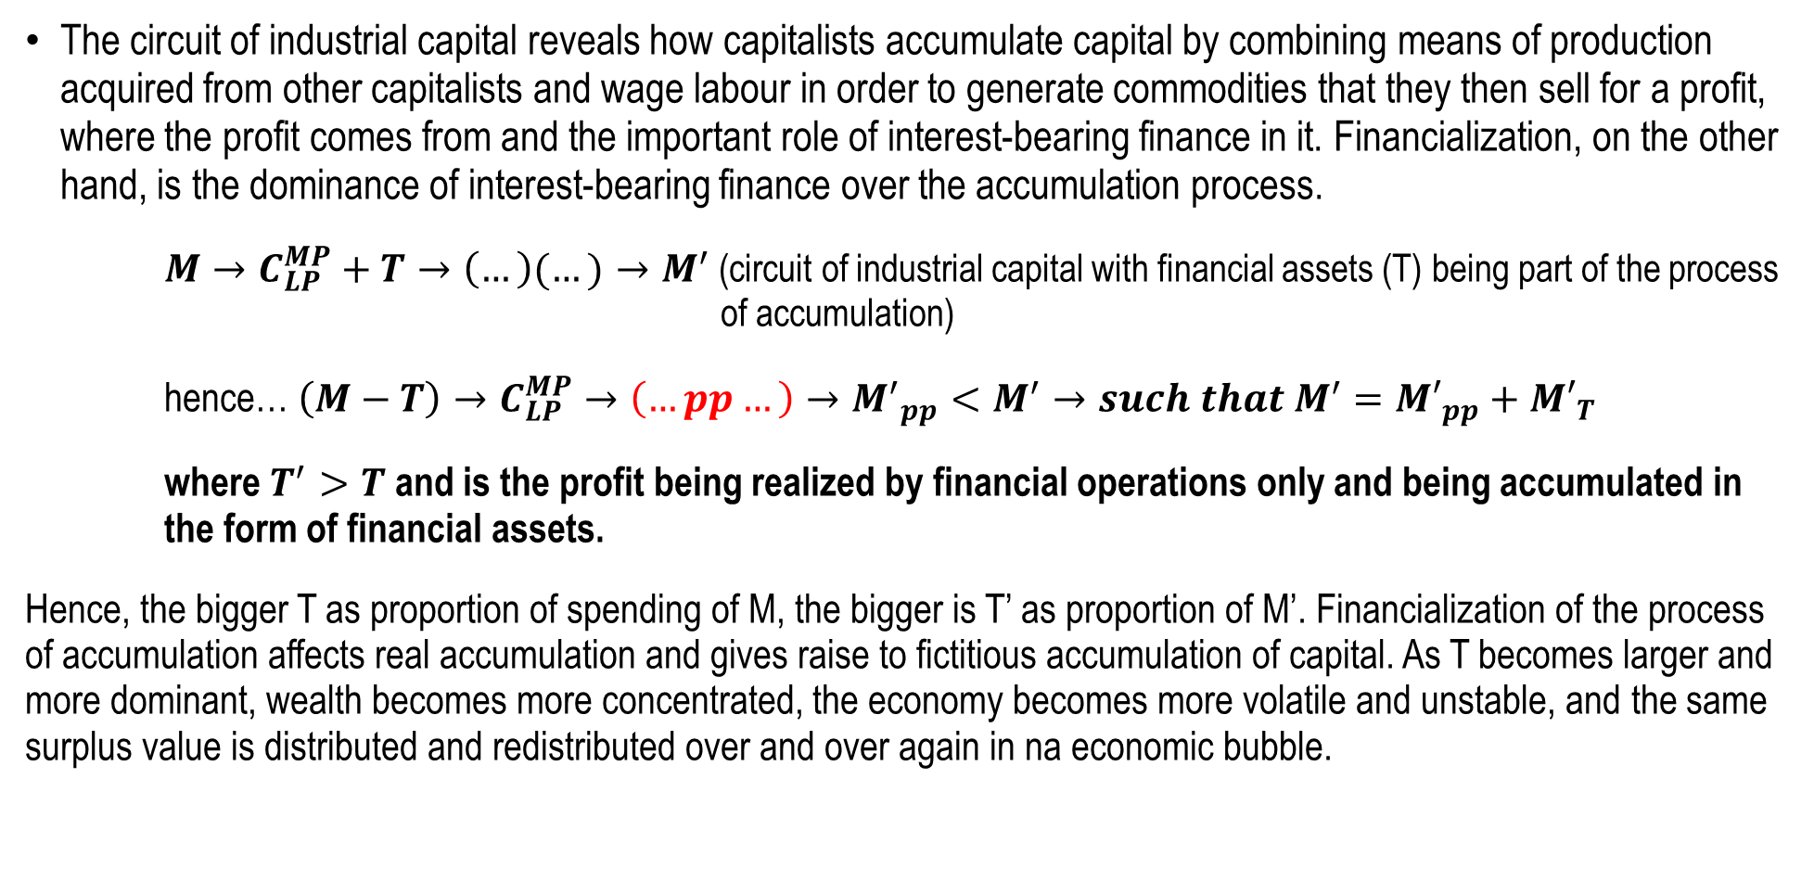
How financialization affects capital accumulation
The circuit of industrial capital reveals how capitalists accumulate capital by combining means of production acquired from other capitalists and wage labour in order to generate commodities that they then sell for a profit, where the profit comes from and the important role of interest-bearing finance in it. Financialization, on the other hand, is the dominance of interest-bearing finance over the accumulation process.
$M→C_{LP}^{MP}+T→\left(…\right)(…)→M^{′}$ (circuit of industrial capital with financial assets (T) being part of the process of accumulation)
hence… $\left(M−T\right)→C_{LP}^{MP}→\left(…pp…\right)→{M^{′}}_{pp}<M^{′}→such that M^{′}={M′}_{pp}+{M′}_{T}$
where $T^{′}>T$ and is the profit being realized by financial operations only and being accumulated in the form of financial assets.
Hence, the bigger T as proportion of spending of M, the bigger is T’ as proportion of M’. Financialization of the process of accumulation affects real accumulation and gives raise to fictitious accumulation of capital. As T becomes larger and more dominant, wealth becomes more concentrated, the economy becomes more volatile and unstable, and the same surplus value is distributed and redistributed over and over again in na economic bubble.

Slide 13
Where does financialization come from?
A product of neoliberalism and one of its main characteristics:
  Deregulation, including of the financial markets, to increase global mobility of capital at higher profit rates (offshores, shadow financing and fiscal heavens are examples of this)
  Concentration and centralization of income and capital – how to transform money into capital at “good enough” rates of return?
  Increased commoditization of the society, including of sectors/services where private capital was excluded from before (such as privatization/deregulation of social security, access to health, education, transports, defence and security, control of strategic resources such as land and strategic energy-minerals), through outsourcing, public/private “partnerships”, monopoly concessions and other means.

Slide 14
Where does financialization come from?
A product of neoliberalism and one of its main characteristics:
  Crises paid for by severe social austerity (cuts in social expenditure, employment, real wages and variations regarding monetary policy – from tight controls to quantitative easing and back). Social austerity cuts “social obligations of capital” (such as taxes and commitments to social protection and decent labour conditions), balances the deficit while enabling the government to focus on rescuing financial markets and institutions, and creates new profit opportunities by privatising and outsourcing social services (in health, education, social security, and so on).
  Expansion of the credit economy (credit cards, for example) to compensate for falling demand associated with stagnation in employment and real wages (please, watch this video online https://www.youtube.com/watch?v=qOP2V_np2c0)
  Increasing risks and debt, coupled with public guarantees, public subsidies and increased public exposure to private debt
  International competition for access to highly concentrated and centralized finance, which promotes product diversification as a way to maximise market dominance and profits.

Slide 15
Social Costs of financialization – global
Concentration and centralization of finance and income (example of the US):
  40 major banks before the crisis merged into 4 even bigger banks (JP Morgan, Chase, Bank of America and Wells Fargo)
  Their major shareholders are the same giant of finance (Black Rock, Vanguard and State Street), which are also the major shareholders in 40% of the companies quoted in the stock exchange, which represents 80% of the US economy
Control of financial assets by the richest families: 80% of the financial assets in Hong Kong, 76% in Malaysia, 48% in Singapore, 47% in Philippines, 34% in Portugal, 29% in France and in Switzerland belong to the 15 richest families, and in Sweden, 63% belong to the 2 richest families.
Control of the process of capital accumulation by fictitious capital, more volatile and speculative economy and contraction of employment and real investment as proportion of surplus.
Submission of state policy and finances to the interests of the financial markets and reduction of the ability of the state to pursue broader economic and social policies (for example, the role of sovereign debt)

Slide 16
Summary
Extensive and intensive accumulation of fictitious capital, this is, the increase in scale, scope and prevalence of financial capital, which is then deployed to create more financial capital, independently of any productive application of such capital, and without consideration about the implications of such process of accumulation on the real economy, employment, distribution and work and living conditions.
Interest bearing capital can control assets (such as firms) but also what/how such firms do and how financial capital is deployed.

Slide 17
Summary
Examples over the last 4 decades: (i) financial transactions share of profits of non-financial organizations increased from 5% to > 45% (so that real investment and employment fell); (ii) weight of finance in global GDP trebled (why do we need 3 times more financial services for the same real transactions?); (iii) increased role for offshores and fiscal heavens.
A product of neoliberalism and one of its main characteristics, namely of extensive deregulation and liberalization, expansion of commoditization and profit opportunities through society, increased role of the state to guarantee and be exposed to private debt, and international competition for access to increasingly more complex, concentrated and centralized finance.

Slide 18
Summary
High social costs for private gain, and expansion and increased intensity of control of public policy and finances by speculative financial markets.
Global crisis paid for by severe social austerity, AND social austerity as new opportunities for expansion of capital – cuts “social obligations”, enables the government to focus on rescuing financial markets and creates new profit opportunities by commoditization of public services.

Slide 19
Bibliography
Duménil, G. and D. Levy. 2012. Neoliberalism. In Fine, B. and A. Saad-Filho. The Elgar Companion to Marxist Economics. Edward Elgar: Cheltenham.
Harvey, D. 2007. A Brief History of Neoliberalism. Oxford University Press: New York.
Milonakis. 2006. Pioneers of economic history. In Jomo and Fine (eds) The new development economics.
Milonakis, D. and B. Fine. 2009. From political economy to economics – method, the social and the historical in the evolution of economic theory
Saad-Filho, Alfredo & Deborah Johnston (editors). 2005. Neoliberalism – a critical reader. Pluto Press: London

Slide 20
Taxas de crescimento do PIB

Slide 25
Crises do capitalismo como crises de acumulação – uma demonstração com base em dinâmicas de financeirização

Slide 26
Crises do capitalismo como crises de acumulação – uma demonstração com base em dinâmicas de financeirização

Slide 27
Crises do capitalismo como crises de acumulação – uma demonstração com base em dinâmicas de financeirização

Slide 28
US: a case of unequal division of the results of labour?

Slide 32


Evidence from the
Oxfam
2019
World
Report

Slide 33
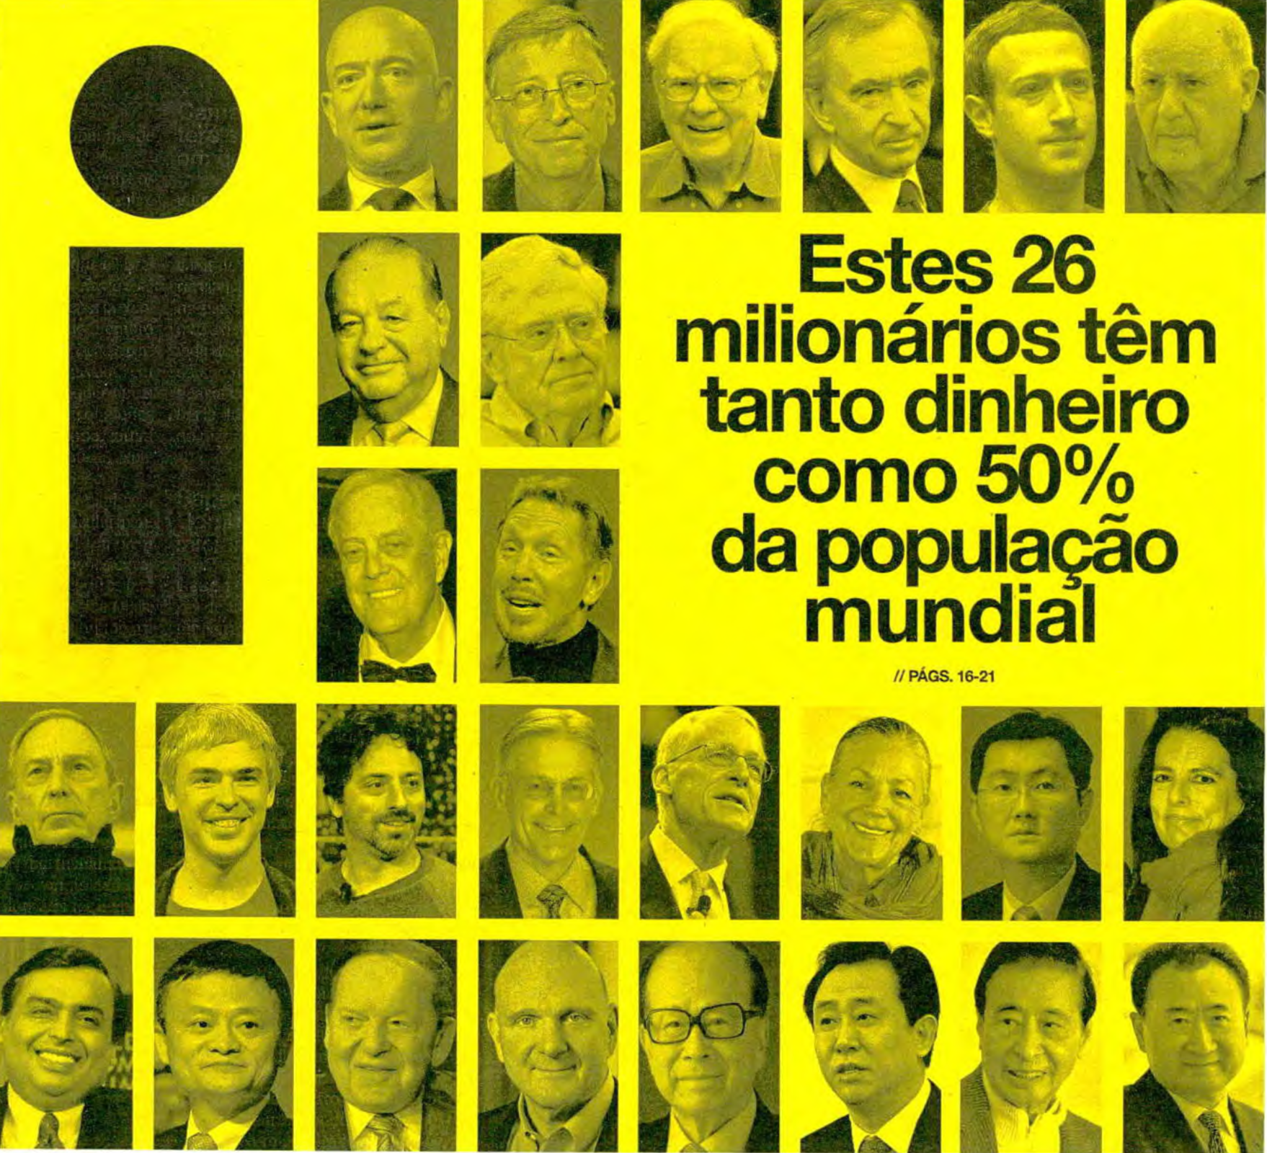

Slide 34
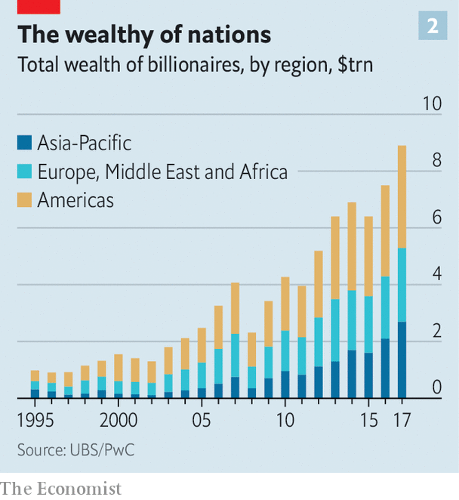
Wealth of billionaires by region

Slide 35
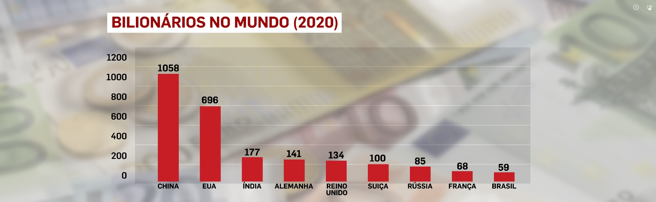
Number of billionaires by country (2020), Hurun Report

Slide 37
Referências
Beckert, Sven & Seth Rockman (editors) (2016) Slavery’s capitalismo
Dobb, Maurice (1963) A evolução do capitalismo
Fine, Ben & Alfredo Saad-Filho (2016) Marx’s capital (sexta edição)
Harvey, David (2015) Seventeen contradictions and the end of capitalism
Mandel, Ernest (1972) Late capitalism.
Marx, Karl [(1887)-(1983)] Capital. Volume I
Rodney, Walter (1974) How Europe underdeveloped Africa
Williams, Eric (1944) British capitalism and British slavery

Slide 38
Bibliografia
Castel-Branco, Carlos (2017). Contribuição para o método de investigação da economia política de Moçambique. In Brito, Luís, Carlos Castel-Branco et al (orgs.) (2017). Desafios para Moçambique 2017. IESE: Maputo (pp. 83-97) https://www.researchgate.net/publication/327729728_CONTRIBUICAO_PARA_O_METODO_DE_INVESTIGACAO_DA_ECONOMIA_POLITICA_DE_MOCAMBIQUE
Fine, Ben (2012) Labour Theory of Value. In Fine, Ben & Alfredo Saad-Filho (eds.) The Elgar Companion to Marxist Economics. Edward Elgar: Cheltenham
Fine, Ben & Alfredo Saad-Filho (2018). Marxist economics. In Fischer, Liliann, et al. (eds.) Rethinking economics – an introduction to pluralista economics. Routledge: New York (pp. 19-32).
Fine, Ben & Alfredo Saad-Filho (2016) Marx’s capital (sexta edição)
Gosh, Jayati (2012) Capital. In Fine, Ben & Alfredo Saad-Filho (eds.) The Elgar Companion to Marxist Economics. Edward Elgar: Cheltenham
Gruffydd-Jones, Branwen (2012) Method of Political Economy. In Fine, Ben & Alfredo Saad-Filho (eds.) The Elgar Companion to Marxist Economics. Edward Elgar: Cheltenham (pp. 220-226)
Harvey, David (2010) A companion to Marx’s Capital. Verso: London.
Tinel, Bruno (2012) Labour, labour power and the division of labour. In Fine, Ben & Alfredo Saad-Filho (eds.) The Elgar Companion to Marxist Economics. Edward Elgar: Cheltenham
Wood, Ellen (2012) Capitalism. In In Fine, Ben & Alfredo Saad-Filho (eds.) The Elgar Companion to Marxist Economics. Edward Elgar: Cheltenham
Zarembka, Paul (2012) Accumulation of Capital. In Fine, Ben & Alfredo Saad-Filho (eds.) The Elgar Companion to Marxist Economics. Edward Elgar: Cheltenham (pp. 5-9)

